Slide 1
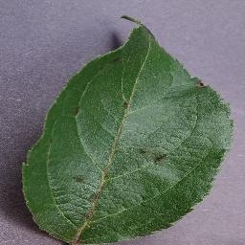
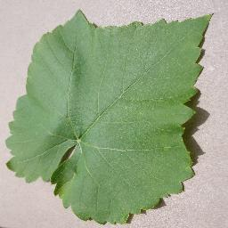
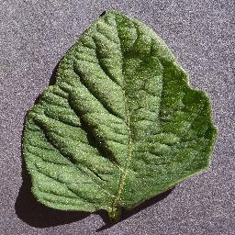



Input
$${P }_{\begin{aligned}Various \\ apples\end{aligned}}$$
Conv 3x3
MBConv1
MBConv6
Conv 1x1
Pooling
FC
...
3×300×300
EfficientNet-B3
$${P }_{\begin{aligned}Various \\ grapes\end{aligned}}$$
...
Scale
Sigmoid
FC
ReLu
FC
Global Pooling
$$P_{\begin{aligned}Various \\ tomatoes\end{aligned}}$$
...
SE
...
Proj Conv2d
Layer Norm
Token Mixing
⊕
Layer Norm
Channel Mixing
⊕
GAP
FC
Output
MLP-Mixer ×4

